Slide 1

Implied volatility directional forecasting: a machine learning approach

Slide 2
The forecasting Process
Problem identification: Asset performance has low association with its volatility during different volatility regimes
Data Gathering: S&P 500 index from Jan 1990 to Dec 2019; 31 macroeconomic factors that influence volatility
Model Comparison: Different models are analysed using a plethora of statistic measures, scores and characteristics to select the best for forecasting
Strategy comparison: Using a set of suggested strategies, we compare the models by their performance

Slide 3
Problem
The directional volatility has little attention when there is a need to build portfolio immunisation strategies.
Notes:
The periods of transition from low to high market volatility can be very abrupt and short-lived, implying the need for portfolio immunisation strategies.

Slide 4
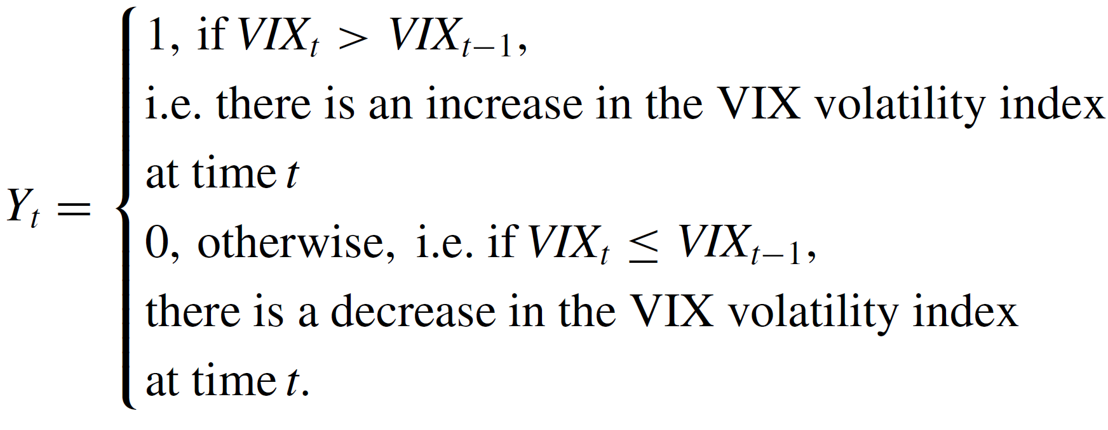
2.1. Methodology, Binary Logit regression models
Notes:
Let’s start discussing machine learning models starting with notation. Y_t is a variable representing change in VIX comparing to last month value. If VIX increased this month, Y_t is 1 and 0 otherwise

Slide 5

2.1. Binary Logit regression models
Generalized linear models (GLM) can be used to model the dependence of the binary directional variable Yt, given a set of N (lagged) covariates or predictor variables, Xj,t−l, j = 1, ... ,N, l = 1, ... , h and/or autoregressive components, Yt−i, i = 1, ... , p. Using logit model we receive equation in the following form:
Notes:
Generalized linear models (GLM) can be used to model the dependence of the binary directional variable Yt, given a set of N (lagged) covariates or predictor variables, Xj,t−l, j = 1, ... ,N, l = 1, ... , h and/or autoregressive components, Yt−i, i = 1, ... , p. Using logit model we receive equation in the following form:

Slide 6
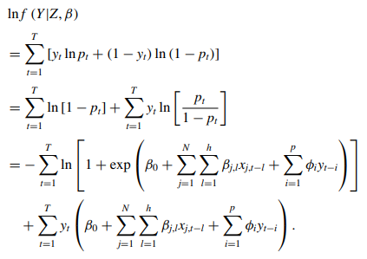
2.1. Binary Logit regression models
The loglikelihood function for a sample of T observations is given by:
Notes:
The loglikelihood function for a sample of T observations is given by:

Slide 7
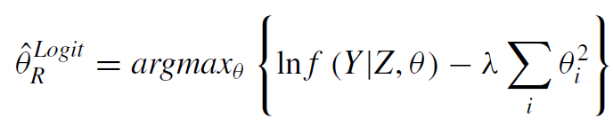
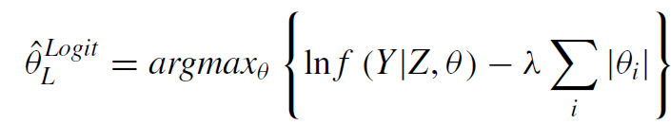
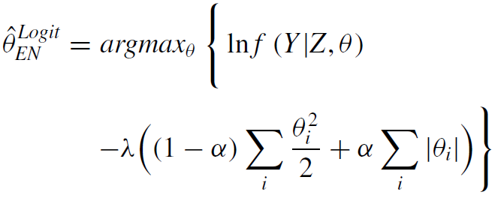
2.2. Penalised likelihood binary logit regression models
Model types: The Ridge Logit model, the LASSO Logit model and the Elastic Net Logit model
Ridge Logit Model MLE
LASSO Logit Model MLE
Elastic Net Logit Model MLE
Notes:
The Ridge, the Least Absolute Shrinkage and Selection Operator (LASSO), and the Elastic Net regularization techniques are presented below, as they are implemented in the empirical analysis

Slide 8




2.3. Discriminant analysis
These techniques are alternative classification tools that overcome certain limitations linked to standard Probit/Logit type regression models:
Linear discriminant analysis
Regularized discriminant analysis
Notes:
These techniques are alternative classification tools that overcome certain limitations linked to standard Probit/Logit type regression models. These are linear discriminant analysis and regularised discriminant analysis

Slide 9
2.4. Classification and Regression Trees
This section presents tree-based solutions to the classification problem. The estimation procedure of the tree structure is usually based on a top-down, greedy algorithm to grow a tree together with a pruning algorithm to avoid overfitting. Unfortunately, they suffer, however, from reduced predictive accuracy and non-robustness. So, a number of ensemble numbers were developed to overcome these issues.
Notes:
Breiman in (1984) offers a flexible way to analyse non-linear relationships between a dependent variable and a set of predictors, where the terminal nodes of the tree correspond to distinct and non-overlapping regions of the partition.The estimation procedure of the tree structure is usually based on a top-down, greedy algorithm to grow a tree together with a pruning algorithm to avoid overfitting. Unfortunately, they suffer, however, from reduced predictive accuracy and non-robustness. So, a number of ensemble numbers was developed to overcome this issues.

Slide 10
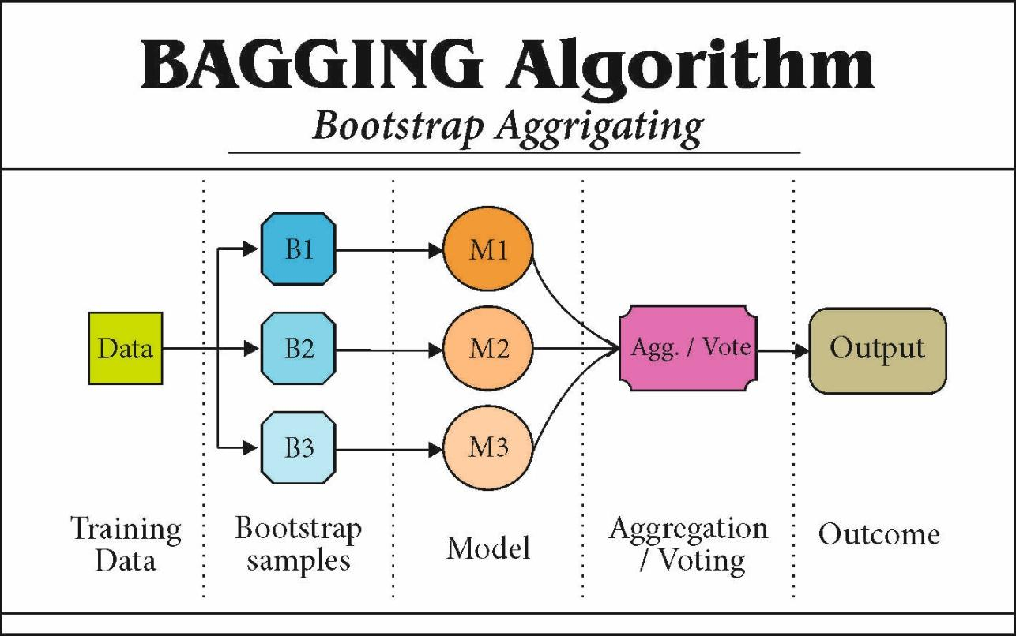
2.4.1. Bagging
Notes:
Bagging algorithm improves the predictive accuracy of a classifier by generating multiple versions of the classifier based on bootstrap replicates of the training data set, and then combines these classifiers in order to create a single one. The specific aggregated process produces a stable forecast/classifier with smaller variance and, thus, succeeds in achieving substantial gains in terms of accuracy.

Slide 11
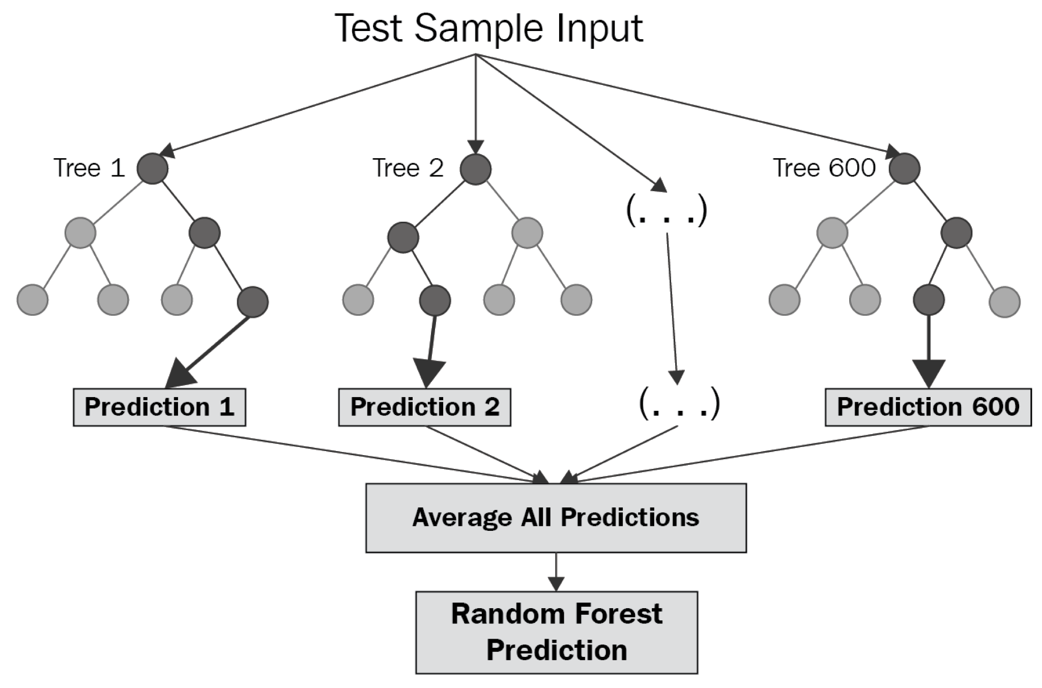
2.4.2. Random Forest
Notes:
The Random Forest classifier found by aggregating different bootstrapped classifiers is similar to that generated by the Bagging technique. There is a significant modification in the way that Random Forest classification trees are created, however. Instead of using the ‘best’ split, like in bagging algorithm, random forest randomly chooses nodes that can participate in finding the ‘best’ split, therefore introducing randomness and reducing variance.

Slide 12
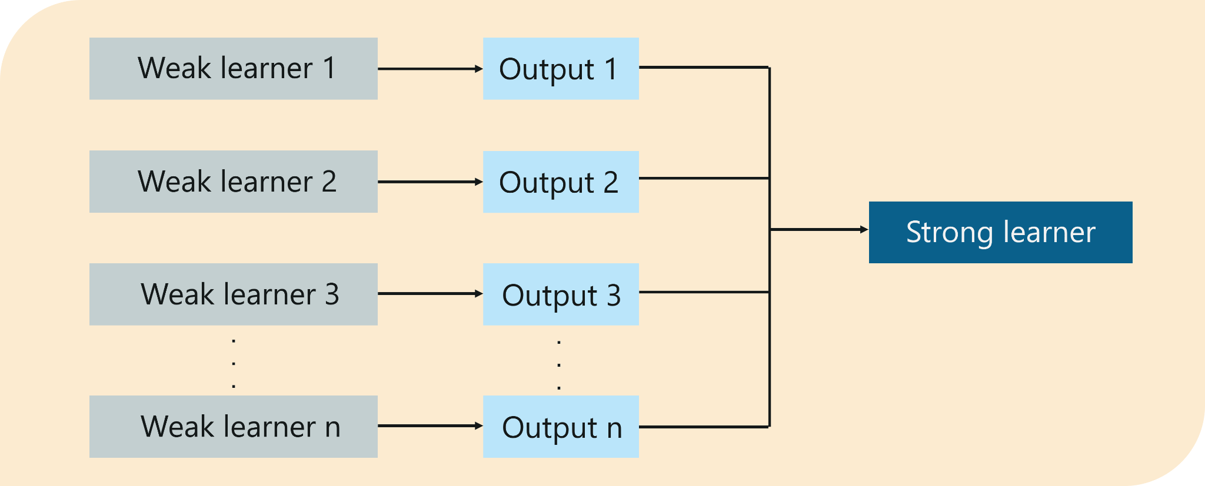
2.4.3. Adaptive boosting
Notes:
Boosting is an ensemble technique that combines several weak classifiers created by resampling to produce a more accurate and powerful classifier by applying weighted majority vote.
Boosting is an ensemble technique that combines several weak classifiers to produce a more accurate and powerful classifier. The basic idea is to combine classifiers that are iteratively created through the resampling of the training data by assigning higher weight to observations that were misclassified, to produce a new classifier that could boost the underlying performance. This process is repeated, generating several classifiers, which are then combined into a final classifier by applying weighted majority vote.

Slide 13
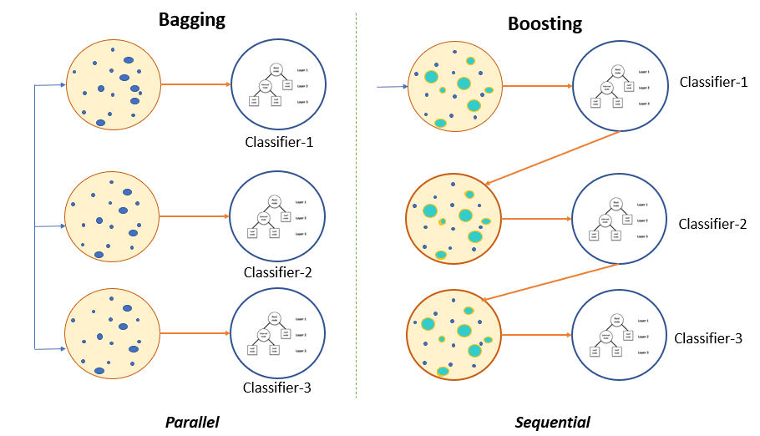
2.4.4. Gradient boosting
Notes:
The core idea of the Gradient Boosting algorithm is to create additive models by sequentially fitting a base (weak) learner to current pseudo-residuals at each iteration. Thus, the learning process fits new models consecutively, to provide a more accurate estimate of the dependent variable.
Friedman developed a framework for the creation of a new generation of boosting techniques, based on boosting’s link to the statistical principles of additive modeling and maximum likelihood. A generic gradient descent ‘boosting’ algorithm is developed (Gradient Boosting) for additive expansions based on different fitting criteria. The core idea of the Gradient Boosting algorithm is to create additive models by sequentially fitting a base (weak) learner to current pseudo-residuals at each iteration. Thus, the learning process fits new models consecutively, to provide a more accurate estimate of the dependent variable.

Slide 14
2.4.5. Recursive Partitioning Algorithm
Recursive Partitioning Algorithms (rpart) are used to create classification and regression models; that is, the resulting models can be represented as binary trees. The algorithm consists of two stages. First is partitioning, at each step the optimal split is found and the algorithm repeats, but for child nodes until the terminal nodes reach minimal sizes or further improvements are impossible. The second part of the algorithm is pruning, so the resulting tree will not be overly complicated.
Notes:
Recursive Partitioning Algorithms (rpart) are used to create classification and regression models; that is, the resulting models can be represented as binary trees. The algorithm consists of two stages. First is partitioning, at each step the optimal split is found and algorithm repeats, but for child nodes until the terminal nodes reach minimal sizes or further improvements are impossible. The second part of the algorithm is pruning, so the resulting tree will not be overly complicated.
Recursive Partitioning Algorithms (rpart) are used to create classification and regression models; that is, the resulting models can be represented as binary trees. The algorithm consists of two stages. First is partitioning, at each step the optimal split is found and algorithm repeats, but for child nodes until the terminal nodes reach minimal sizes or further improvements are impossible. The second part of the algorithm is pruning, so the resulting tree will not be overly complicated.

Slide 15
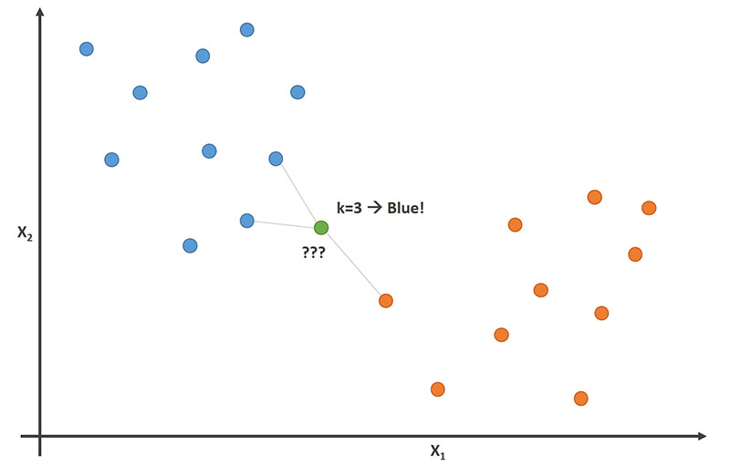
2.4.6. K-Nearest Neighbour
Notes:
k-Nearest Neighbor (k-nn) is a non-parametric technique used for classification. The new observation is classified based on the majority vote of its neighbors, i.e. the new observation is assigned to the class that is most common among its k nearest neighbors.
k-Nearest Neighbor (k-nn) is a non-parametric technique used for classification. It is a distance-based classifier that takes into account the similarity of the predictive variables at a future time period with the observations of the training set. Then, the new observation is classified based on the majority vote of its neighbors, i.e. the new observation is assigned to the class that is most common among its k nearest neighbors.

Slide 16
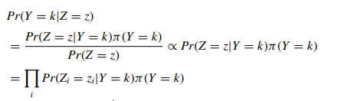

2.4.7. Naive Bayes
The Naive Bayes learning scheme applies the Bayes theorem and assumes conditional independence of the predictors given the classifier.
Formula for Naive Bayes classifier
Notes:
The Naive Bayes learning scheme applies the Bayes theorem and assumes conditional independence of the predictors given the classifier.

Slide 17
2.4.8. Bayesian generalised linear model
To implement the Bayesian generalised linear model in the problem of interest, the approach proposed by Gelman et al. (2009) is applied, using the ’bayesglm’ function, that finds the approximate posterior mode and variance using extensions of the classical generalised linear model computations. The proposed prior distribution setting enables the production of stable, regularized estimates, even when there is separation in Logit regression, and allows for an automated process in applied data analysis.
Notes:
The Bayesian generalised linear model uses the ’bayesglm’ function, that finds the approximate posterior mode and variance using extensions of the classical generalised linear model computations. The proposed prior distribution setting enables the production of stable, regularized estimates and allows for an automated process in applied data analysis.

Slide 18
3. Data collection
01
Resources
04
Data division
Data was collected from 6 different reliable sources.
First 167 monthly observations are used as training set (in-sample), while the rest 192 observations used to evaluate predictive performance (out-of-sample).
02
Predictors
Part of them is widely-followed by policymakers and practitioners.
05
Resampling
Parameters of each model are tuned by cross-validation and resampling.
03
Relevance
The data cover the period between Jan 1990 to Dec 2019.
Example of predictors: oil prices; factor portfolios; dollar index

Slide 19
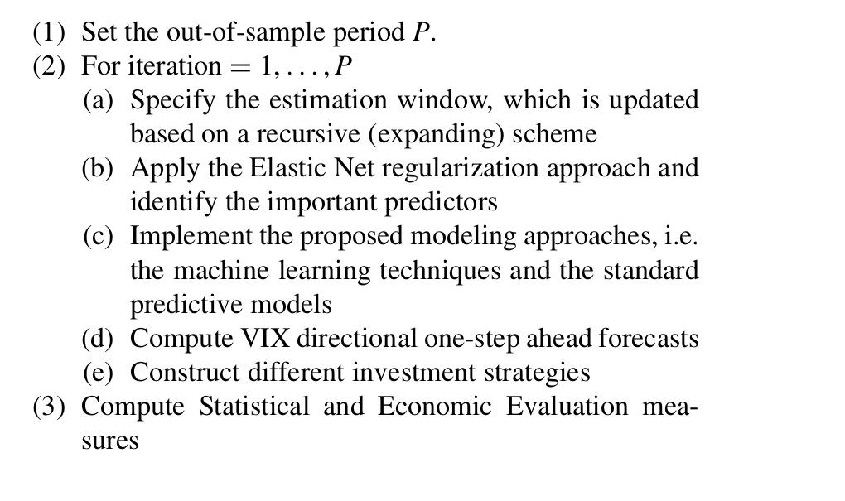
Experiments - idea
Evaluate out-of-sample statistical and economic performance of the different models.
Create real-time investment strategies to measure economic significance.
Apply a recursively-updating algorithm.

Slide 20
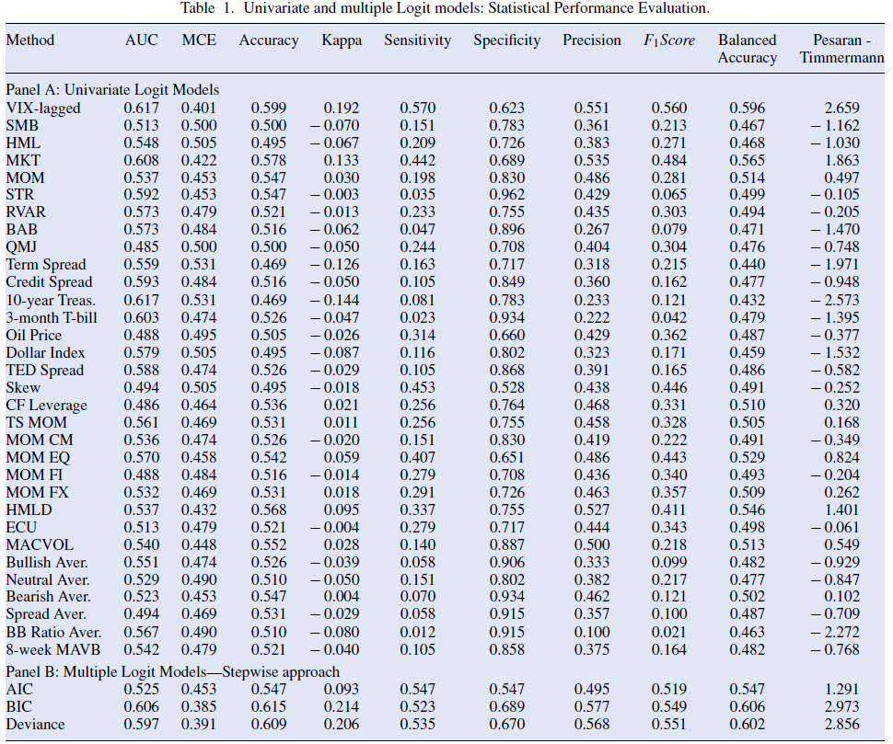
Experiment 1 : Variable stat.Evaluation
Table A:
Train a univariate Logit model
Evaluate using AUC, Accuracy and MCE statistics
Calculate significance using Pesaran-Timmermann
Autoregressive predictor most significant, which is consistent with our results
Table B:
Train multiple Logit model using stepwise regression framework.
Base on the AIC, BIC and Deviance metrics.
BIC and Deviance outperform AIC, which is consistent with our results.

Slide 21
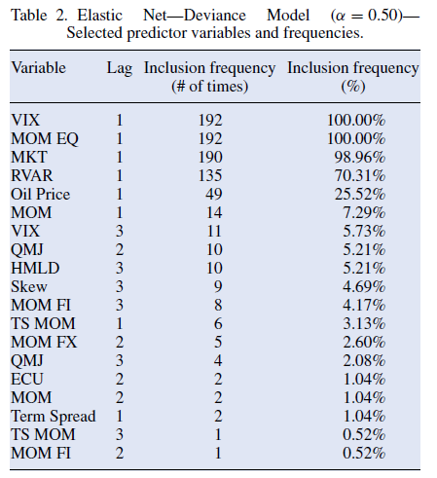
Experiment 2 & 3 : Variable Selection
Used the Elastic-Net method for variable selection under a deviance metric and alpha = 0.5.
The results demonstrate that the lagged VIX(t-1), MOM EQ, MKT, RVAR and OIL PRICE are important variables for predicting VIX direction.
Repeated the experiment with alpha = 0.75, producing similar results.

Slide 22
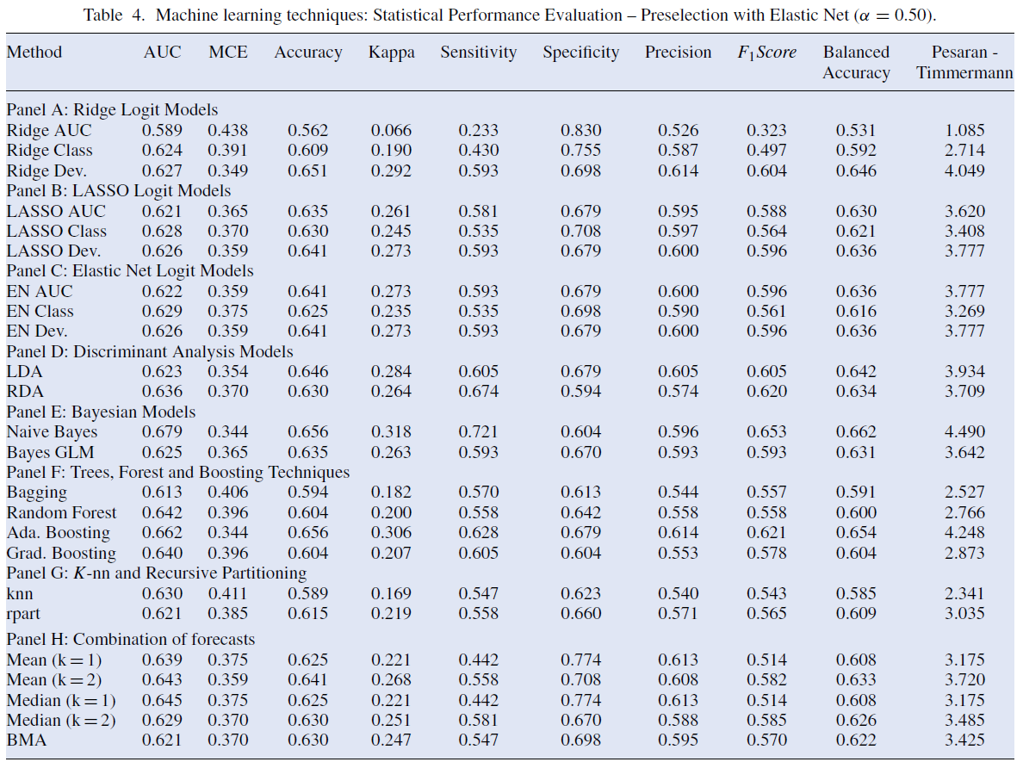
Experiments 4 & 5 : ML stat.Performance
The ability of ML techniques is evaluated with the aim to provide even more accurate VIX forecasts.
Results show that most methods are well-suited for predicting VIX direction.
Boosting performs well (similar to our results).
To assess robustness, experiment was repeated with alpha = 0.75 producing same results.

Slide 23
Investment strategies
Devised investment strategies to evaluate the economic significance of the estimated models.
Long the VIX index when forecasted a rise.
Long the VIX index when forecasted to rise and short when forecasted to fall.
When VIX is expected to trend lower, S&P 500 index is acquired.
*For strategies 2 & 3: when forecast lies between 45% and 55%, no position is taken. If it’s above 55%, then the strategy goes long the VIX index. If below 45%, short VIX index.

Slide 24
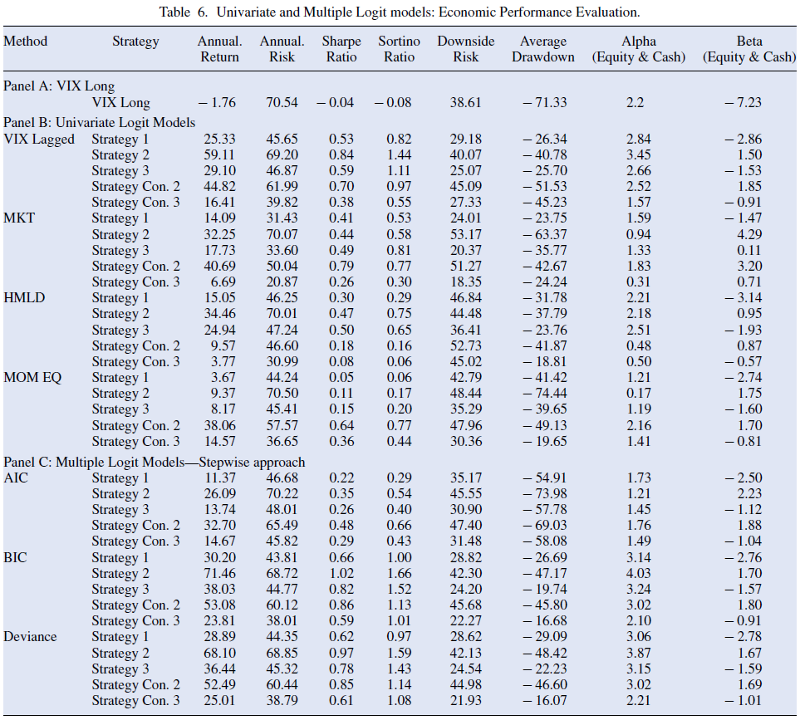
Experiment 6 : Variable performance
Evaluated strategies under predictors showing good performance in experiment 1
Results reaffirm the predictive performance of the lagged variable and the MKT.
Produce suboptimal results for other univariate predictors.
BIC and Deviance based models produce best results for multivariate models.
This is consistent with our results.

Slide 25
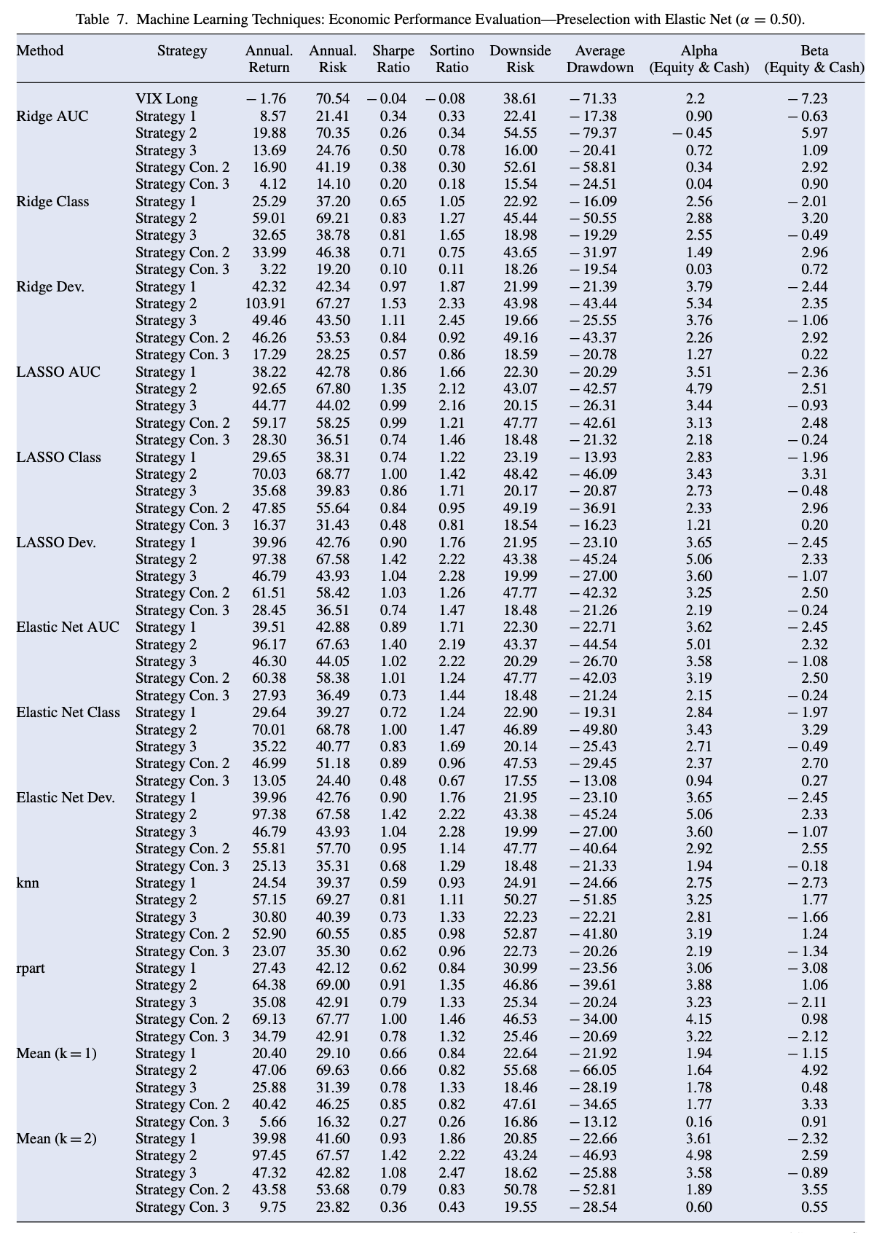
Experiments 7 & 8 ML performance
Economic performance evaluated using ML models.
Naive Bayes, Ridge Deviance and Discriminant analysis produce best results.
Clearly outperform univariate and multivariate Logit models.
Experimented was repeated with alpha =0.75, producing similar results.
ML algorithms are well-suited to predict implied volatility.

Slide 26
Conclusion
The main conclusion is that the application of certain machine learning techniques in implied volatility prediction is strongly encouraged, as it significantly improves the accuracy of out-of-sample forecasts. These predictions are more effective compared to mainstream econometric models.

Slide 27
Thank you for your attention!

